Slide 1

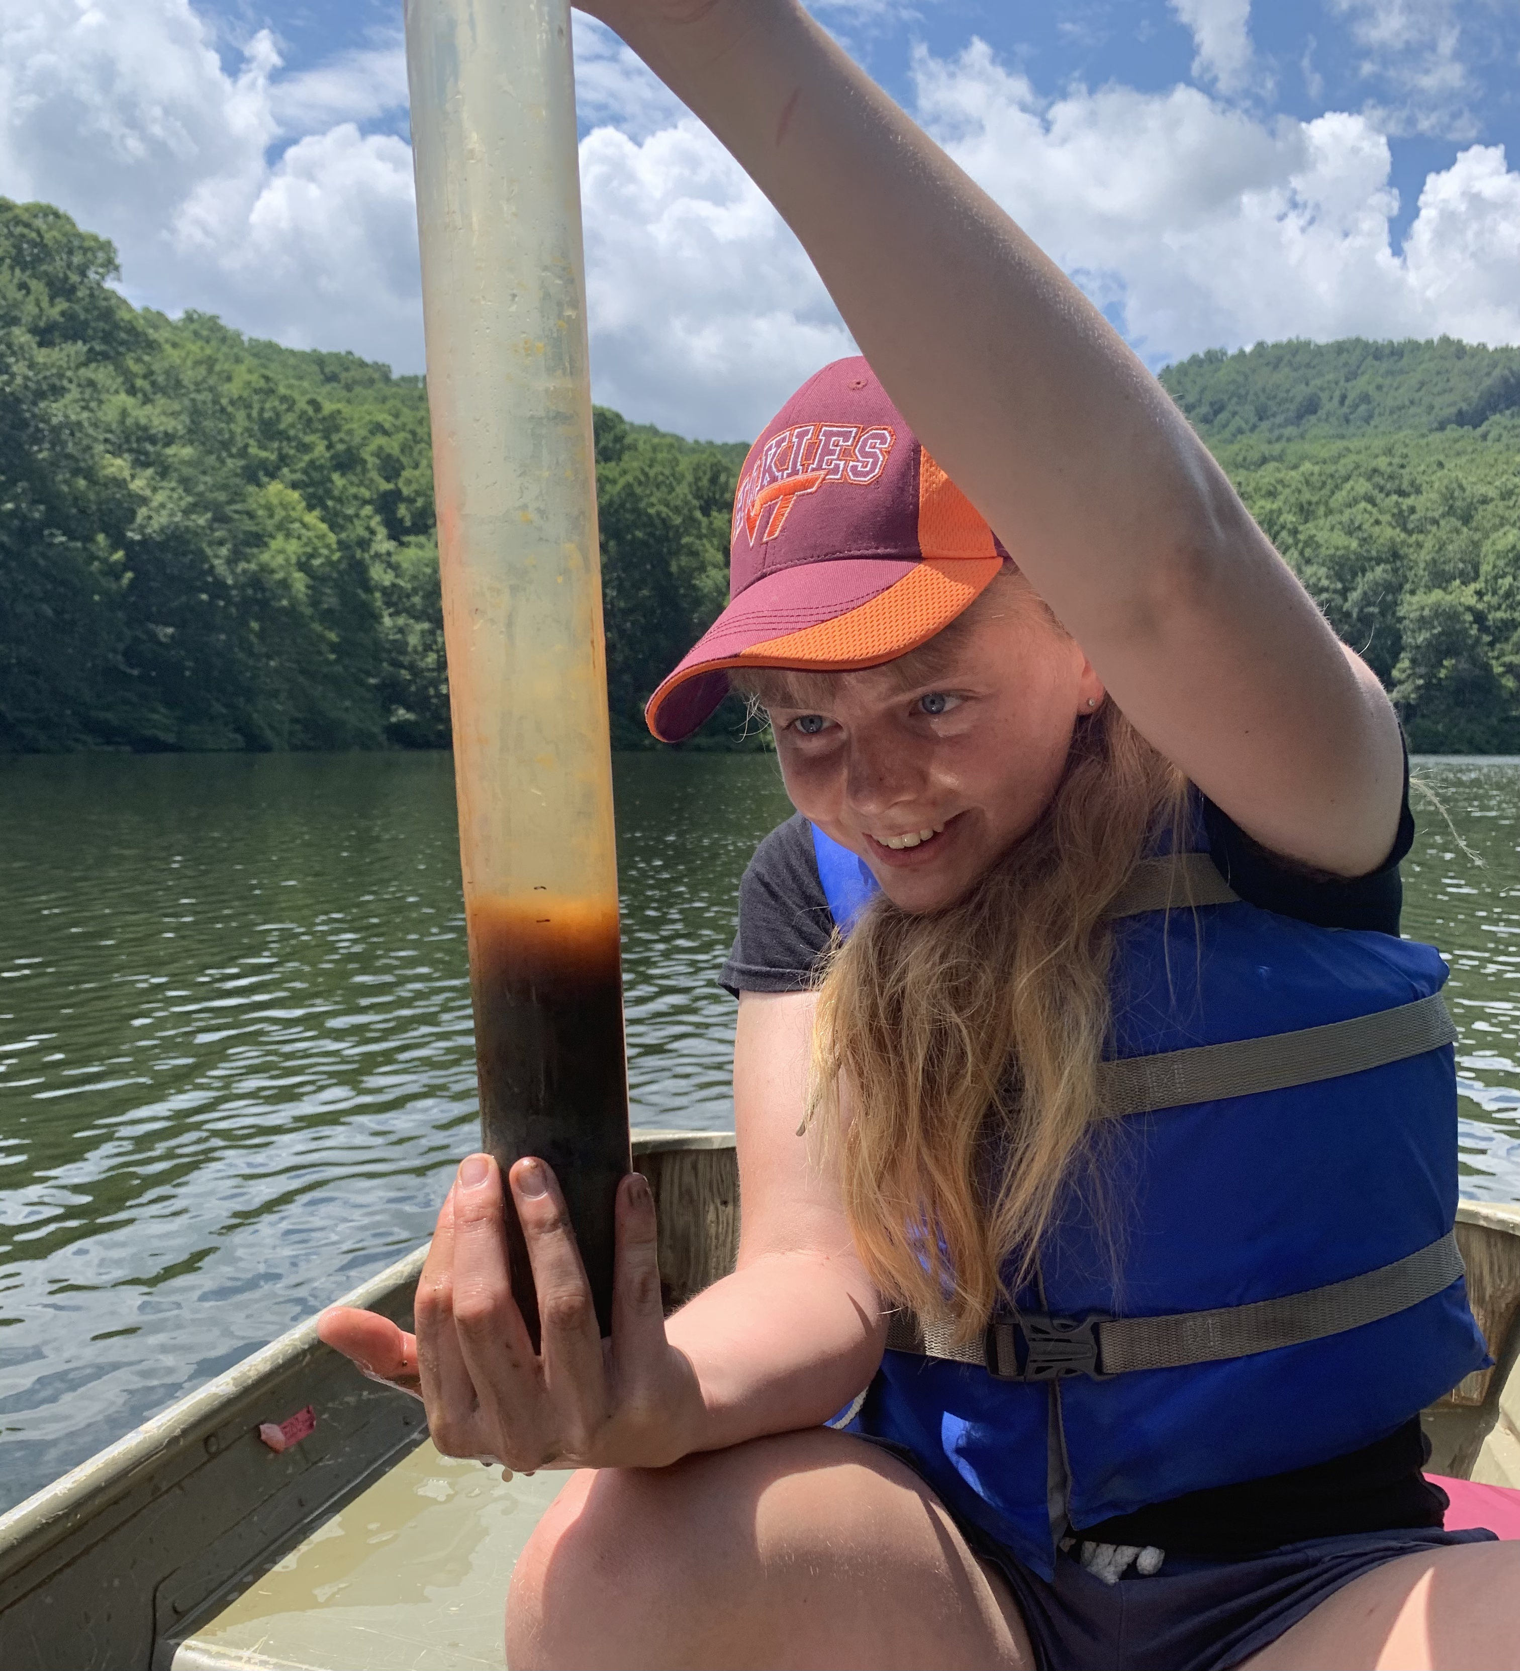

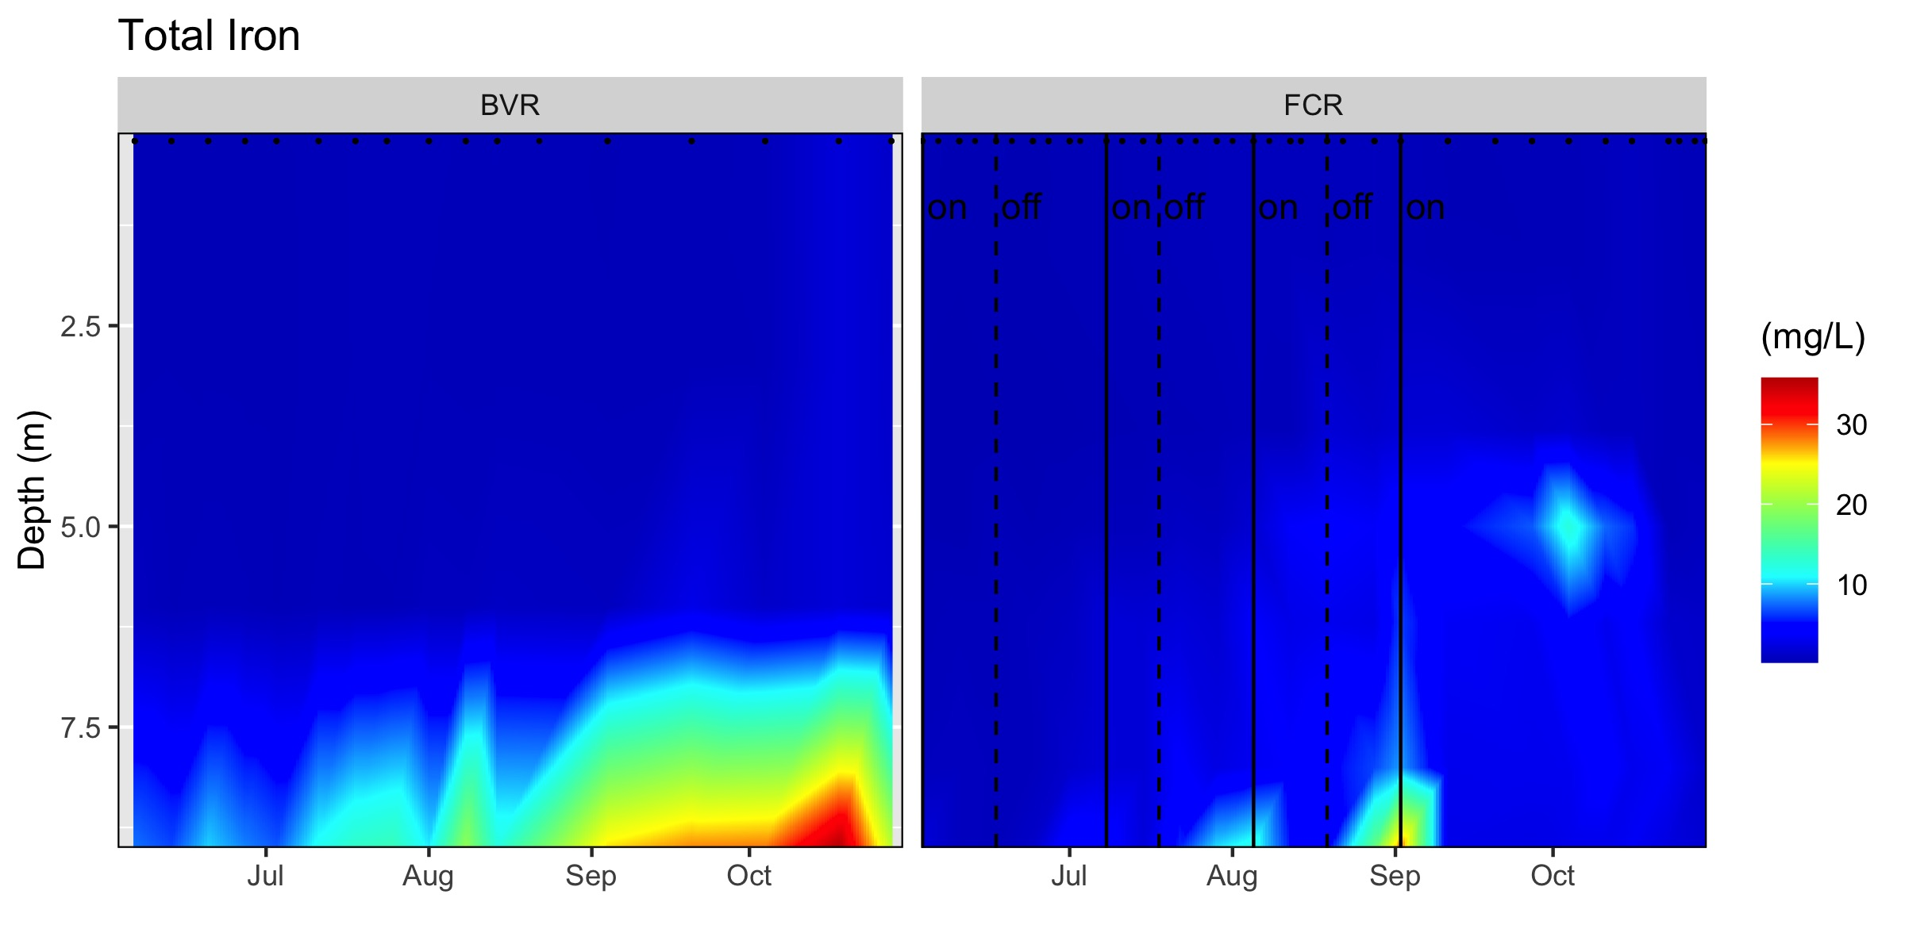
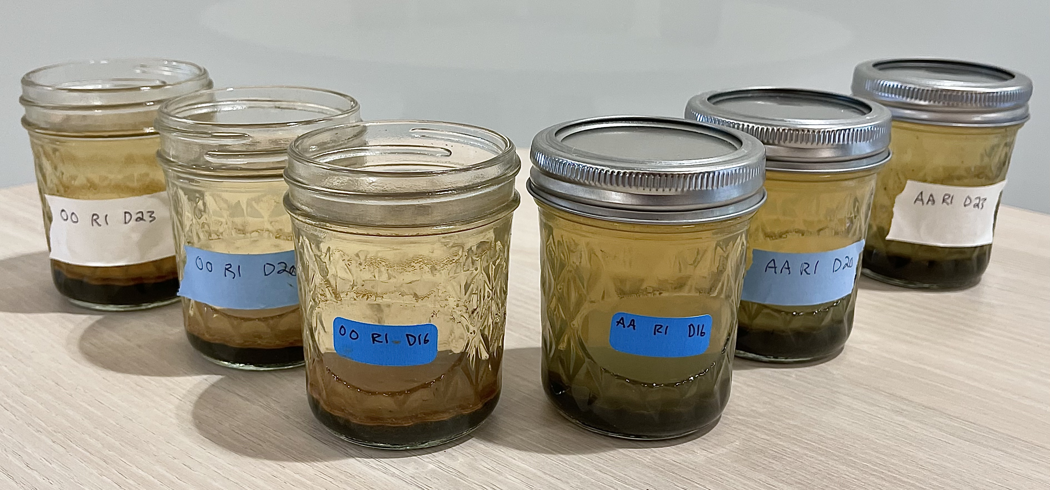
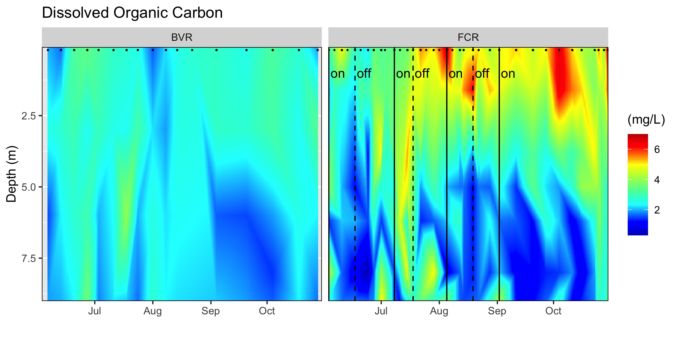
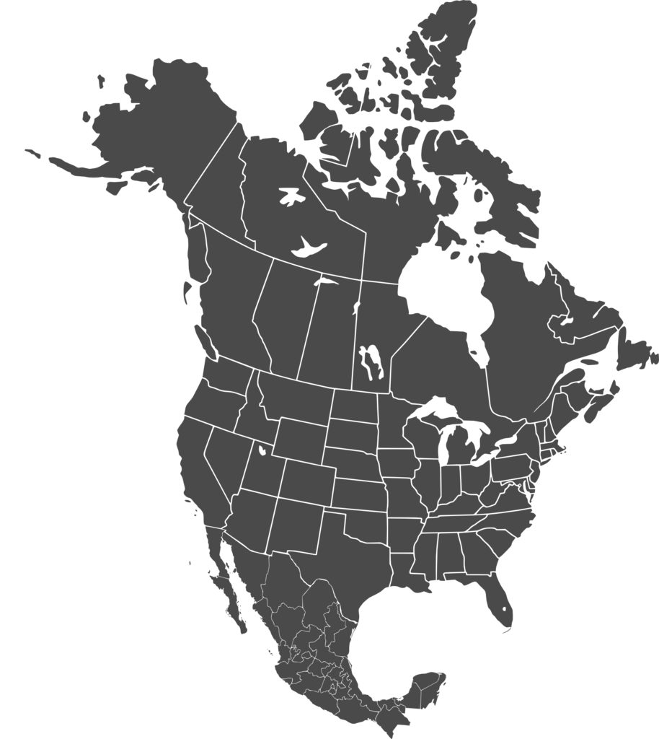
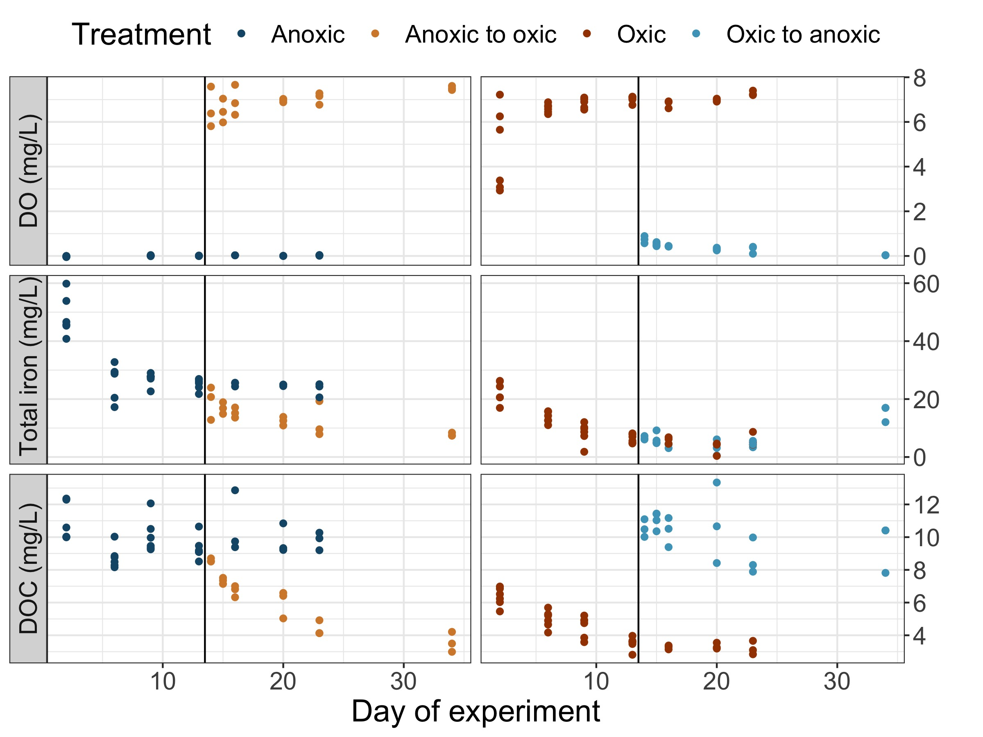
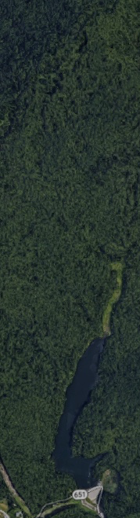
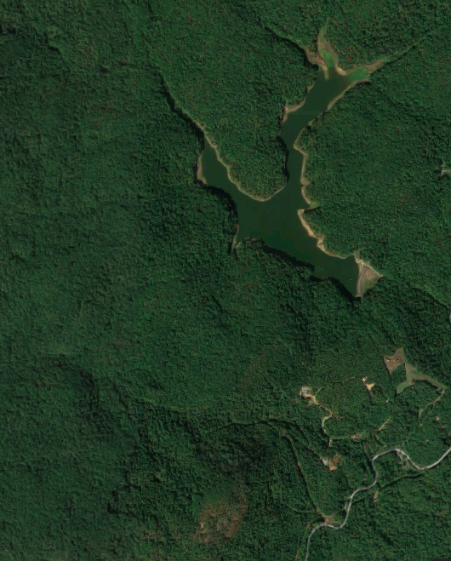
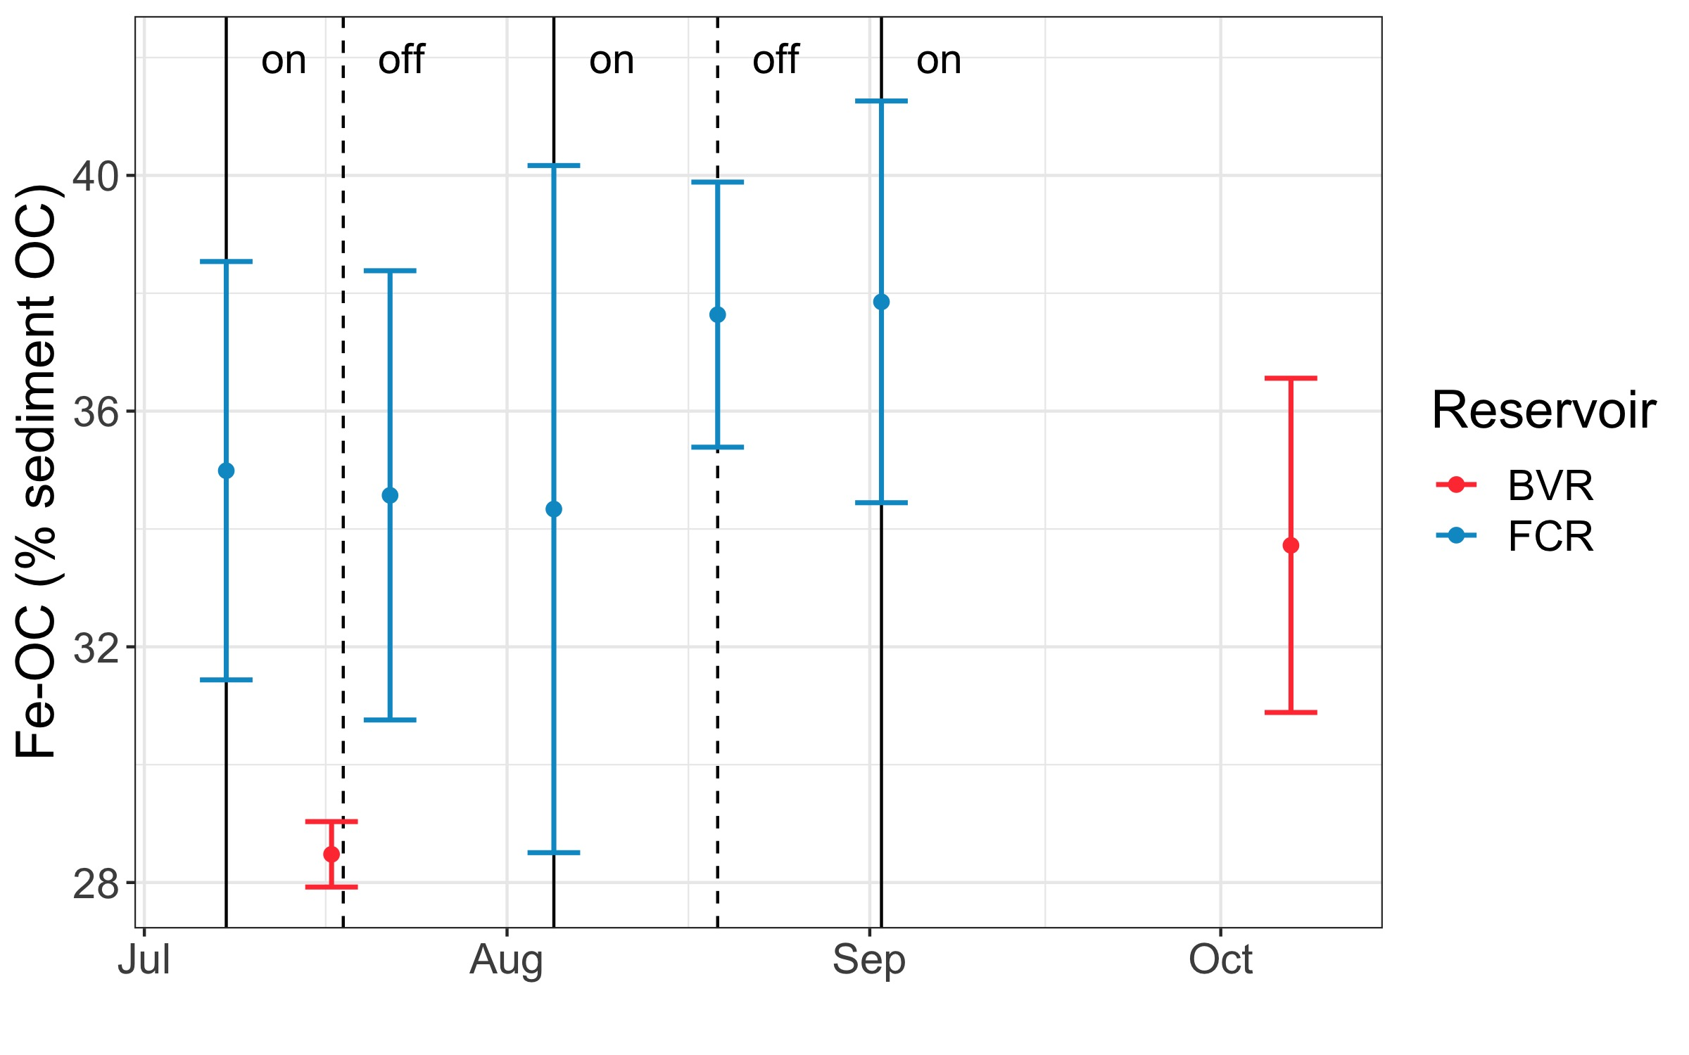

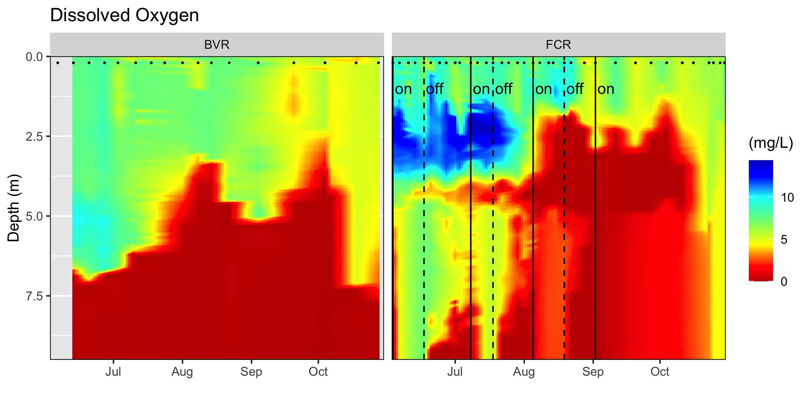
High levels of iron-bound organic carbon correspond to multi-annual oxygenation history in two reservoirs
Abigail S. L. Lewis¹, B. R. Niederlehner¹, Arpita Das¹, Nicholas W. Hammond², Madeline E. Schreiber², Cayelan C. Carey¹
¹Department of Biological Sciences, Virginia Tech, Blacksburg, VA, USA
²Department of Geosciences, Virginia Tech, Blacksburg, VA, USA
aslewis@vt.edu
@lewis_lakes
ACKNOWLEDGEMENTS: Many thanks to the Carey Lab (past and present) and the Western Virginia Water Authority for enabling this research. This work is supported by NSF DEB-1753639.
BACKGROUND
Hypolimnetic concentrations of iron and dissolved organic carbon were suppressed by oxygenation in FCR.
MICROCOSM EXPERIMENT ISOLATES MECHANISM DRIVING SHORT-TERM CHANGES IN DISSOVED IRON AND ORGANIC CARBON
Associations between iron (Fe) and organic carbon (OC) play a critical role in marine carbon burial¹
The importance of these associations in freshwater sediment is poorly understood^{2, 3}
Better quantifying Fe-OC dynamics under varying oxygen conditions would help predict carbon cycling in the face of global change.
Figure 2: Heatmaps of total iron and dissolved organic carbon concentrations in BVR and FCR throughout the stratified period of 2019. Points indicate sampling dates. Lines indicate activation and deactivation of the oxygenation system in FCR.
To more precisely understand the role of iron in carbon sequestration under variable oxygen conditions, we performed a controlled laboratory experiment using sediment and hypolimnetic water from FCR.
Oxic
Anoxic
WHOLE-ECOSYSTEM OXYGENATION EXPERIMENTS HIGHLIGHT THE IMPACT OF ANOXIA ON IRON AND ORGANIC CARBON CLCYING
Both iron and carbon showed clear responses to oxygen treatments. However, the pattern of response varied between variables. Data on iron-bound organic carbon are forthcoming.
Reservoirs are important sites for carbon processing, burying more carbon than oceans each year. Here, we used whole-ecosystem experiments to test the sensitivity of Fe-OC to changing oxygen levels in two reservoirs:
Falling Creek Reservoir (FCR)
Built in 1898
9.3 m max depth
Hypolimnetic oxygenation system has been operated since 2013, maintaining oxic conditions
Beaverdam Reservoir (BVR)
Built in 1872
11 m max depth
Reference reservoir
Iron-bound organic carbon concentrations (determined using dithionite extractions) were higher than those previously reported for lakes^{1, 3}, and comparable to ocean sediments¹. Concentrations differed between reservoirs, but not between oxygenation intervals in FCR.
Treatments created immediate and dramatic differences in dissolved oxygen
Beaverdam
Reservoir
Iron concentrations decreased with oxygen but were slow to increase after the onset of anoxia (Fe²⁺ complexing with other mineral phases in sediment?)
Falling Creek Reservoir
DOC decreased with oxygen (due to both mineralization and Fe complexation) and increased rapidly following the onset of anoxia
1 km
Whole-ecosystem oxygenation experiments successfully increased oxygen concentrations in FCR, relative to BVR.
Figure 1: Heatmap of dissolved oxygen concentrations in BVR and FCR throughout the stratified period of 2019. Points indicate sampling dates. Lines indicate activation and deactivation of the oxygenation system in FCR.
Figure 4: Dissolved oxygen (top), total iron (middle), and dissolved organic carbon (DOC; bottom) concentrations in each of four oxygen treatments. Vertical line indicates the date upon which the oxygen condition was changed for “Anoxic to oxic” and “Oxic to anoxic” treatments.
REFERENCES
Figure 3: Iron-bound organic carbon (Fe-OC) as a percentage of the total sediment organic carbon in the top 1 cm of sediment from FCR and BVR during the stratified period of 2019. Dotted and dashed lines indicate activation and deactivation of the hypolimnetic oxygenation system in FCR, respectively.
¹ Lalonde, K., A. Mucci, A. Ouellet, and Y. Gélinas. 2012. Preservation of organic matter in sediments promoted by iron. Nature 483: 198–200.
² Peter, S., O. Agstam, and S. Sobek. 2017. Widespread release of dissolved organic carbon from anoxic boreal lake sediments. Inland Waters 7: 151–163.
³ Peter, S., and S. Sobek. 2018. High variability in iron-bound organic carbon among five boreal lake
sediments. Biogeochemistry 139: 19–29.

